Slide 1

Azure Administrator - AZ-104
Module 01: Identity

Slide 2
Module Overview
Lesson 01: Azure Active Directory
Lesson 02: Users and Groups
Lesson 03: Module 01 Lab

Slide 3
Lesson 01: Azure Active Directory

Slide 4

Azure Active Directory Overview
Azure Active Directory
Azure AD Concepts
AD DS vs. Azure Active Directory
Azure Active Directory Editions
Azure AD Join
Self-Service Password Reset
Review

Slide 5
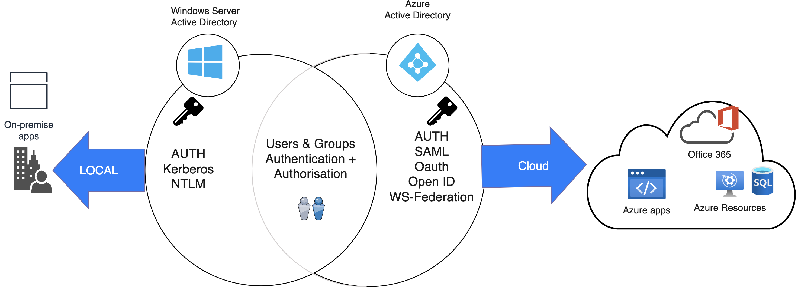
Azure Active Directory
A cloud-based suite of identity management capabilities that enables you to securely manage access to Azure services and resources for your users
Provides application
management, authentication, device management, and hybrid identity
Notes:
Manage Azure identities and governance (15-20%)
Manage Azure AD objects
Configure Azure AD join
Configure self-service password reset

Slide 6
Azure AD Concepts
Concept | Description
Identity | An object that can be authenticated
Account | An identity that has data associated with it
Azure AD account | An identity created through Azure AD or another Microsoft cloud service
Azure AD tenant/directory | A dedicated and trusted instance of Azure AD, a Tenant is automatically created when your organization signs up for a Microsoft cloud service subscription​ ​ Additional instances of Azure AD can be created​ Azure AD is the underlying product providing the identity service​ The term Tenant means a single instance of Azure AD representing a single organization​ The terms Tenant and Directory are often used interchangeably​
Azure subscription | Used to pay for Azure cloud services
Notes:
Azure AD Terminology - https://docs.microsoft.com/en-us/azure/active-directory/fundamentals/active-directory-whatis#terminology

Slide 7
AD DS vs Azure Active Directory
Azure AD is primarily an identity solution, and designed for HTTP and HTTPS communications
Queried using the REST API over HTTP and HTTPS. Instead of LDAP
Uses HTTP and HTTPS protocols such as SAML, WS-Federation, and OpenID Connect for authentication (and OAuth for authorization). Instead of Kerberos
Includes federation services, and many third-party services (such as Facebook)
Azure AD users and groups are created in a flat structure, and there are no Organizational Units (OUs) or Group Policy Objects (GPOs)
Notes:
Compare Active Directory to Azure Active Directory - https://docs.microsoft.com/en-us/azure/active-directory/fundamentals/active-directory-compare-azure-ad-to-ad
✔️ Azure AD is a managed service. You only manage the users, groups, and policies. Deploying AD DS with virtual machines using Azure means that you manage the deployment, configuration, virtual machines, patching, and other backend tasks. Do you see the difference? How are they similar?

Slide 8
Azure Active Directory Editions
Feature | Free | Microsoft 365 Apps | Premium P1 | Premium P2
Directory Objects | 500,000 objects | No object limit | No object limit | No object limit
Single Sign-On | Unlimited | Unlimited | Unlimited | Unlimited
Core Identity and Access | X | X | X | X
B2B Collaboration | X | X | X | X
Identity & Access for O365 |  | X | X | X
Premium Features |  |  | X | X
Hybrid Identities |  |  | X | X
Advanced Group Access |  |  | X | X
Conditional Access |  |  | X | X
Identity Protection |  |  |  | X
Identity Governance |  |  |  | X
Notes:
Azure AD Pricing Editions - https://azure.microsoft.com/en-us/pricing/details/active-directory/
✔️ Did you look through the pricing list to determine which features your organization needs and to compare edition capabilities?

Slide 9
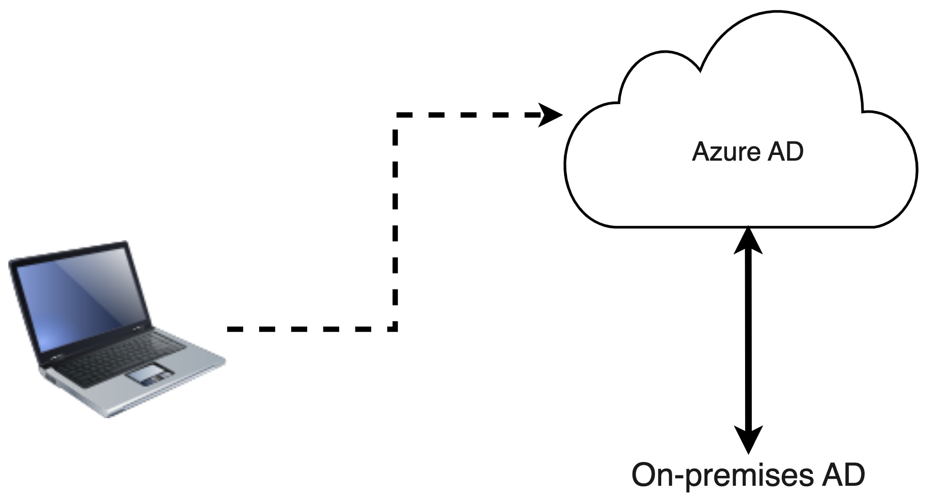
Azure AD Join
Single-Sign-On to your Azure-managed SaaS apps and services
Access to Microsoft Store for Business
Restriction of access to apps from only compliant devices
Enterprise state roaming of user settings across joined devices
Windows Hello support
Seamless access to
on-premises resources
Notes:
Azure AD joined devices - https://docs.microsoft.com/en-us/azure/active-directory/devices/concept-azure-ad-join
✔️ Although AD Join is intended for organizations that do not have on-premises Windows Server Active Directory infrastructure it can be used for other scenarios like branch offices.

